Slide 1

Final project Job Offers
Shghalny
شغلني

Slide 2
Team Members
Mohamed Elshafei (Supervisor)
Mohamed Shehab
Ramadan Esaam

Slide 3
Outline
Simple System Analysis
Database Diagram
Future Plan
Implementation
Tools

Slide 4
Simple System Analysis
Pages
Authorization
Users

Slide 5
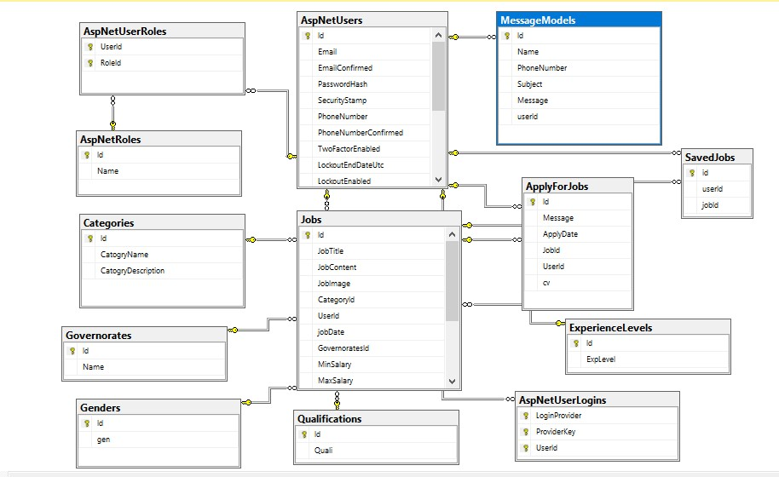
Database

Slide 6

Tools
SQL Server Management Studio
Microsoft Visual Studio

Slide 7

Languages
Asp.Net (MVC)
C Sharp
HTML 5
CSS 3
Bootstrap 5
Jquery

Slide 8

Online JobOffers Features (Update)
Access to the site with outside social account
Advanced Job Search(Filtering)
Active and Bot chat
Job Alert / Notifications
High Security
Implementation (Azura - GoDaddy)

